Slide 1
Reinforcement
Learning
By
Aniruddha Sadhukhan
CSE 2015/004

Slide 2
Reinforcement Learning
Close to human learning
Training by rewards & punishment
Agent learns behaviour through trial-and-error interactions with dynamic environment
Learn how to act in order to maximize a numerical reward

Slide 3
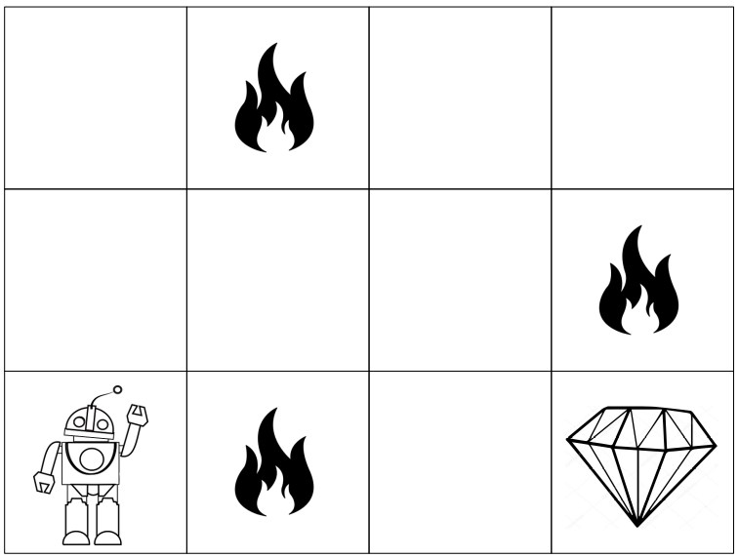
Example
Goal of robot
    Get the reward: diamond
    Avoid the hurdles: fire.
Each right step gives the robot a reward
Each wrong step subtracts the reward
Robot try all the possible paths & chooses the path which gives the reward with the least hurdles.
The total reward will be calculated when it reaches the final reward: diamond.

Slide 4
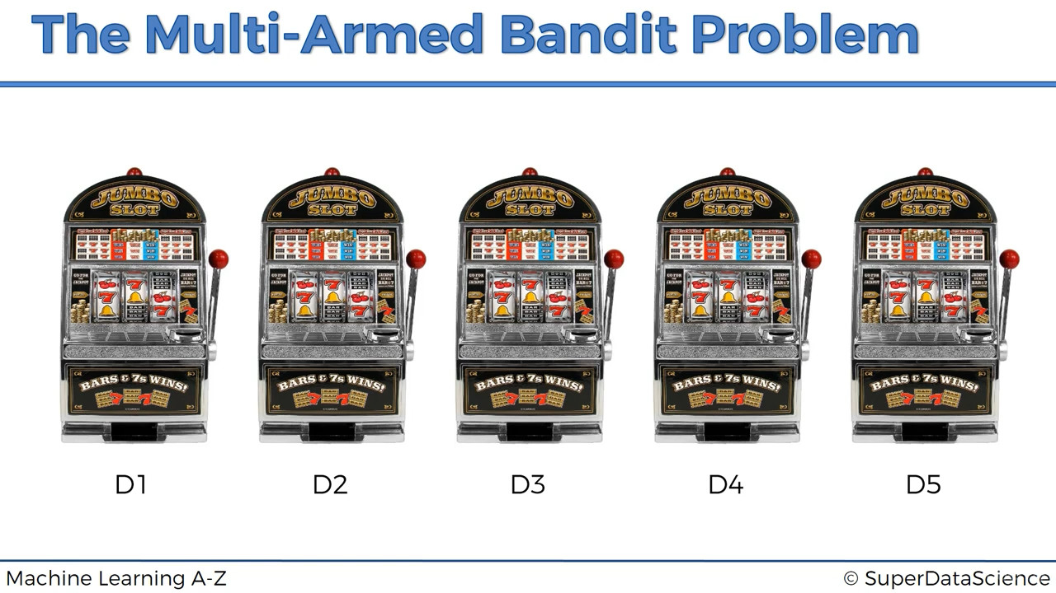

Slide 5
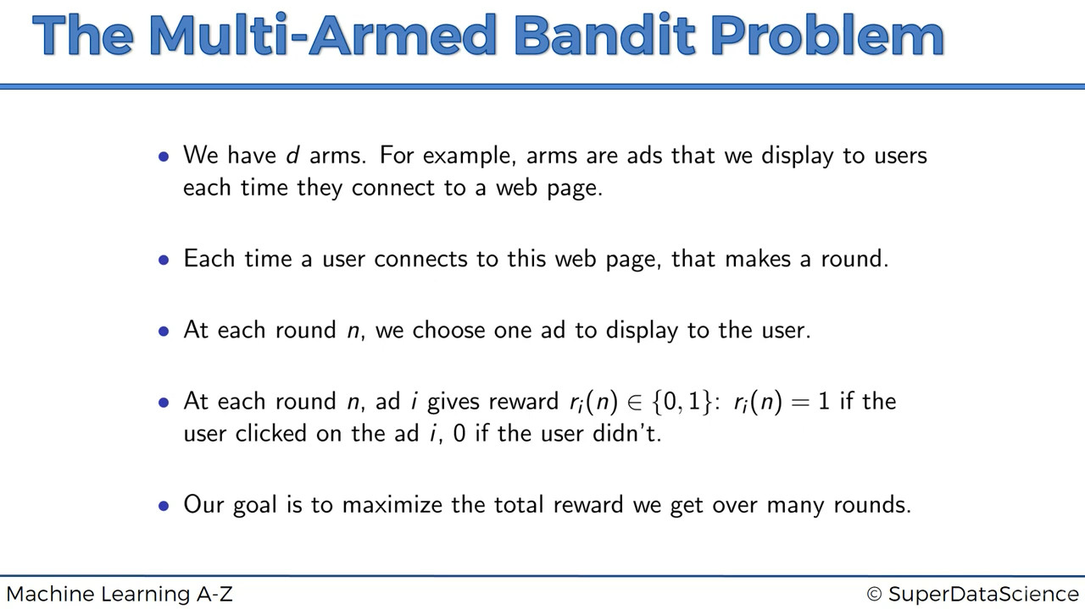

Slide 6
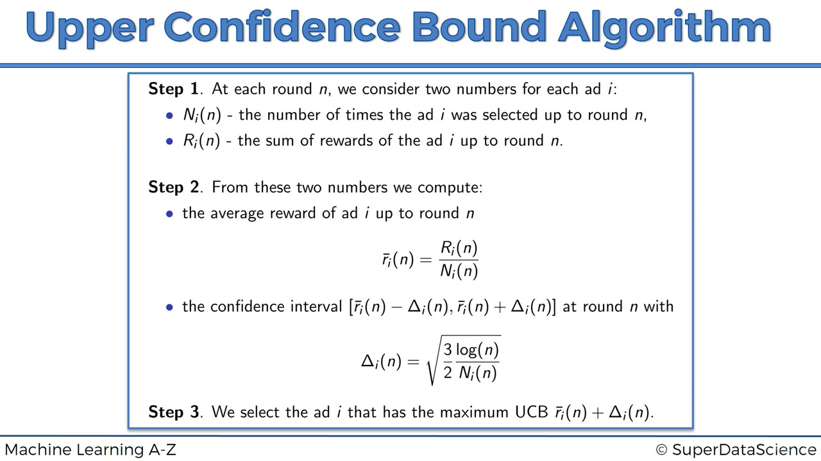

Slide 7
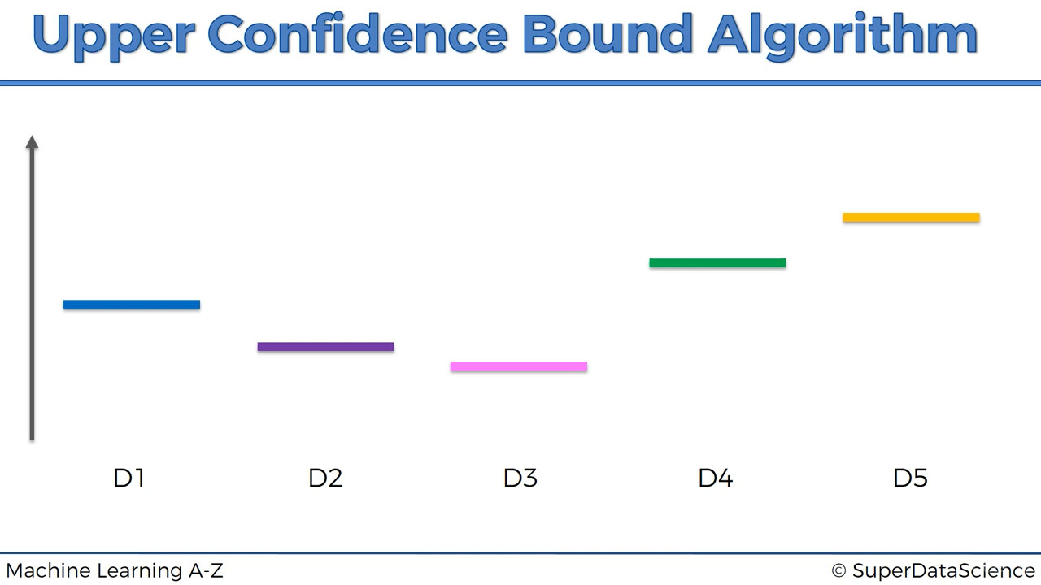
Expected Returns for each bandits
(Not known to user)

Slide 8
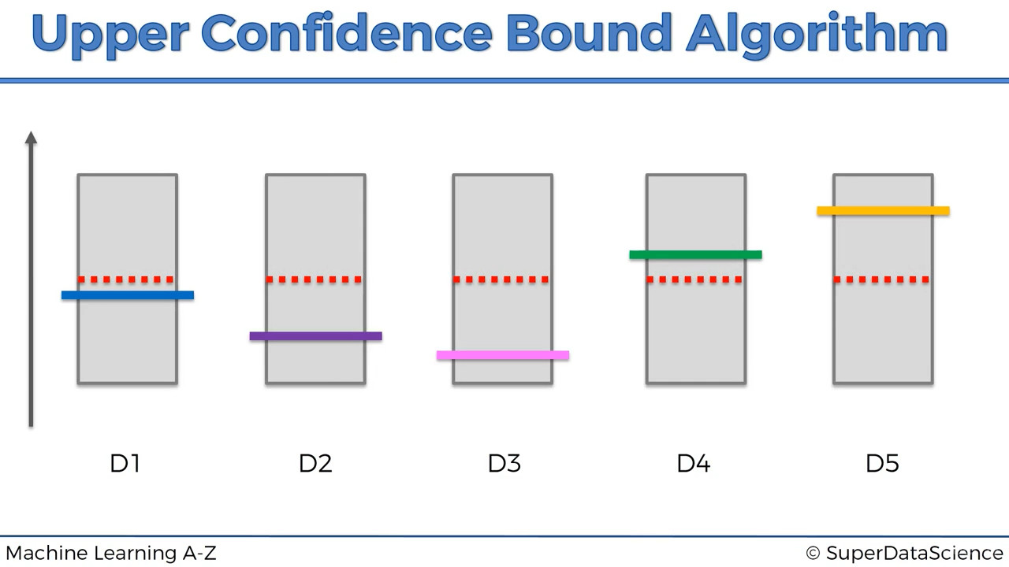
Initial Return Value
Initial Confidence Band

Slide 9
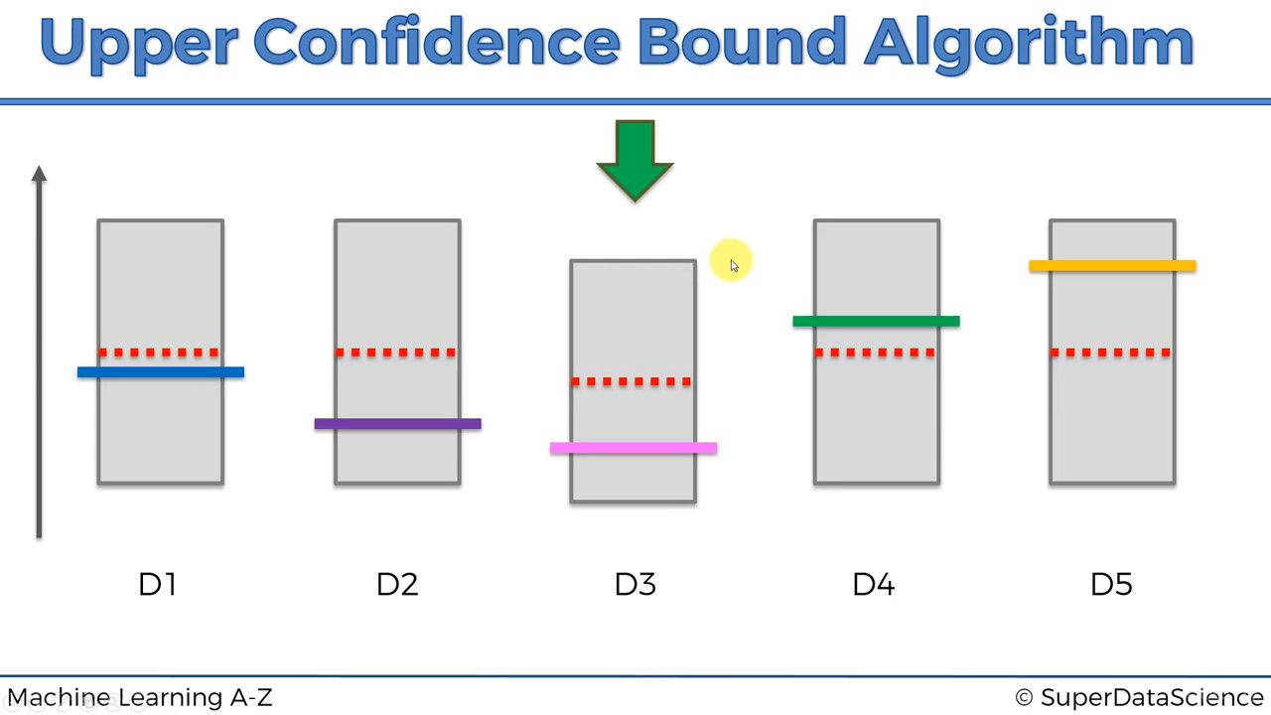
Pick the one having highest confidence bound
(Any one in case of same value)
Let D3 is operated and reward = 0
Observed average returns goes down
Confidence band shrinks

Slide 10
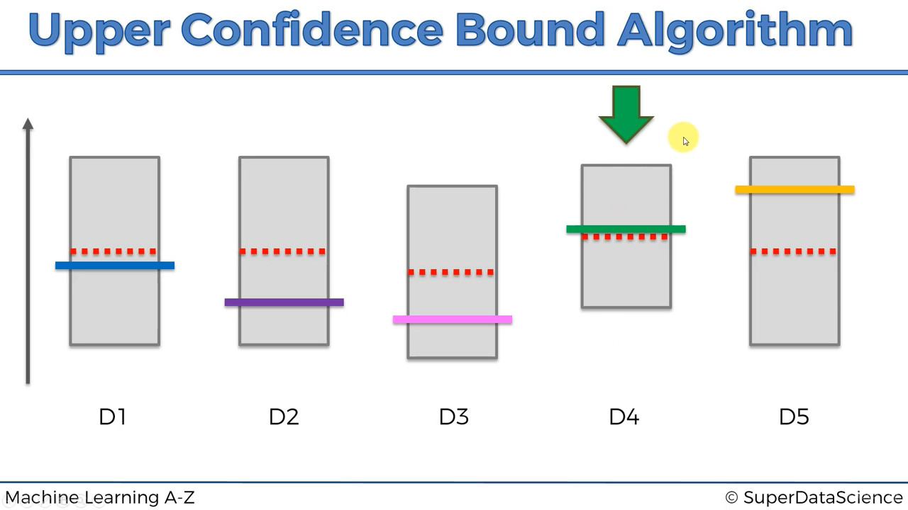
D4 is operated and reward = 1
Observed average returns goes up
Confidence band shrinks
Pick the one having highest confidence bound
(Any one in case of same value)

Slide 11
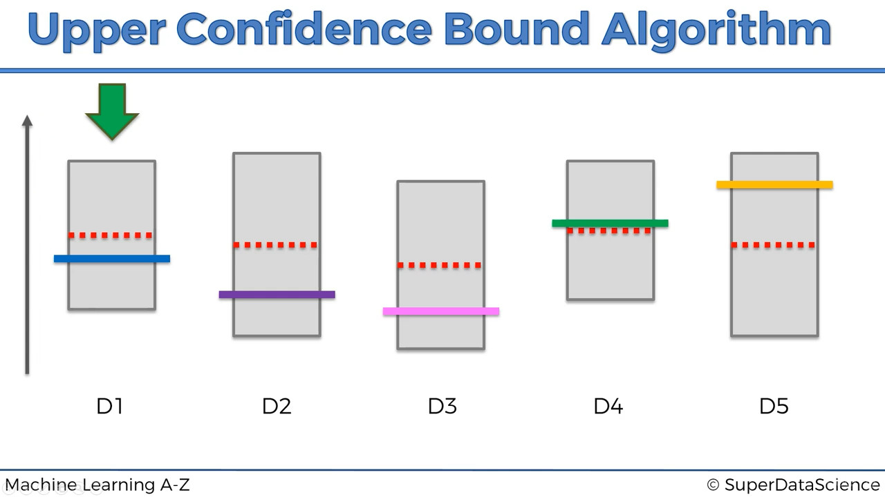
D1 is operated and reward = 1
Observed average returns goes up
Confidence band shrinks
Pick the one having highest confidence bound
(Any one in case of same value)

Slide 12
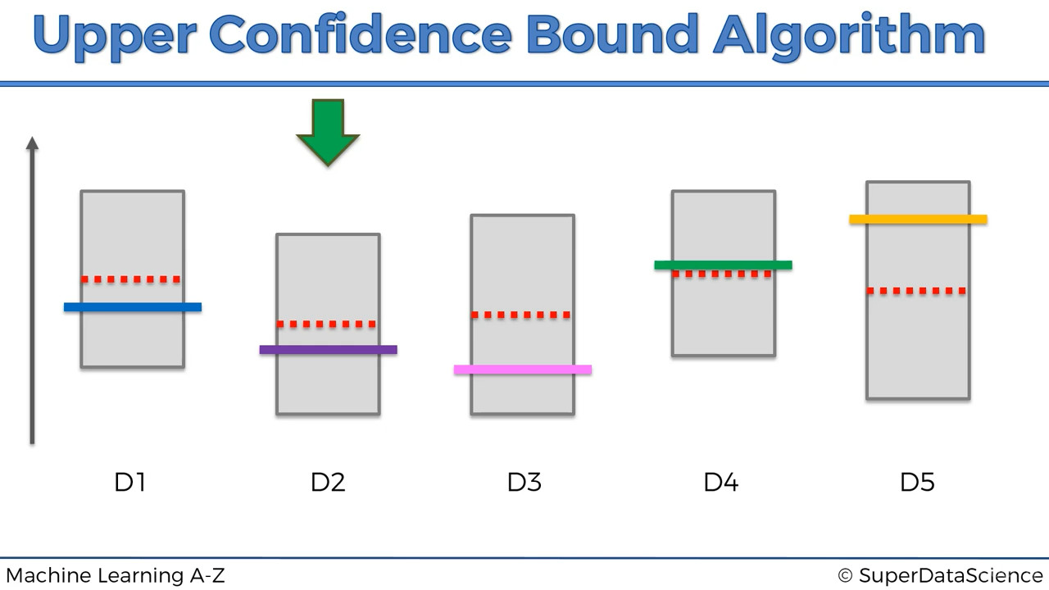
Pick the one having highest confidence bound
(Any one in case of same value)
D2 is operated and reward = 0
Observed average returns goes down
Confidence band shrinks

Slide 13
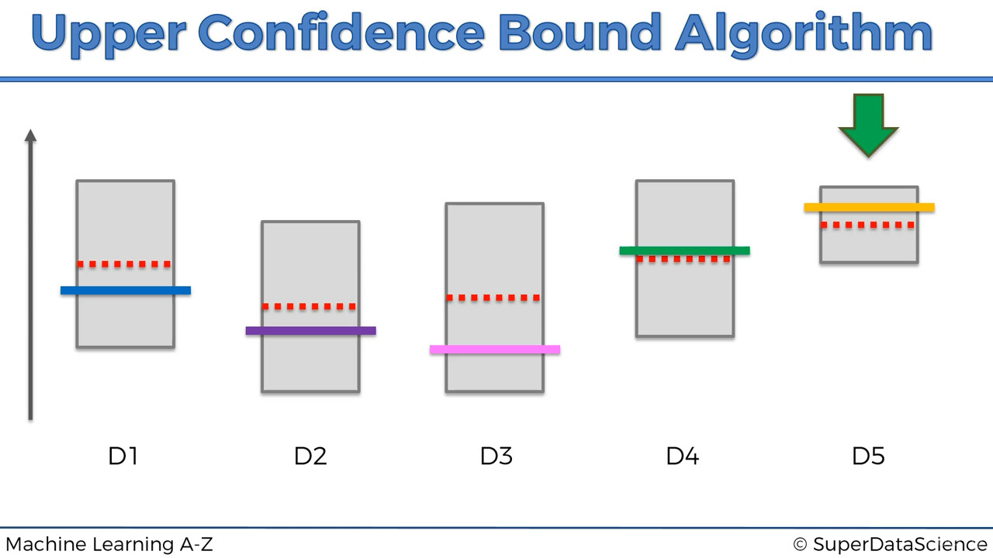
Pick the one having highest confidence bound
(Any one in case of same value)
D5 is operated and reward = 1
Observed average returns goes up
Confidence band shrinks

Slide 14
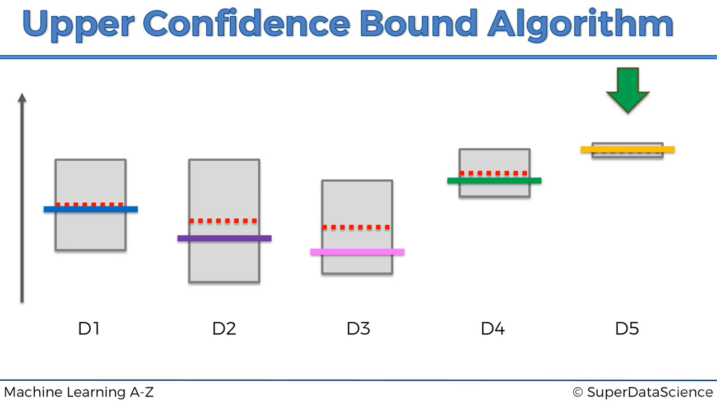
After many rounds, D5 has higest upper confidence bound repeatedly
So, D5 is prefered

Slide 15
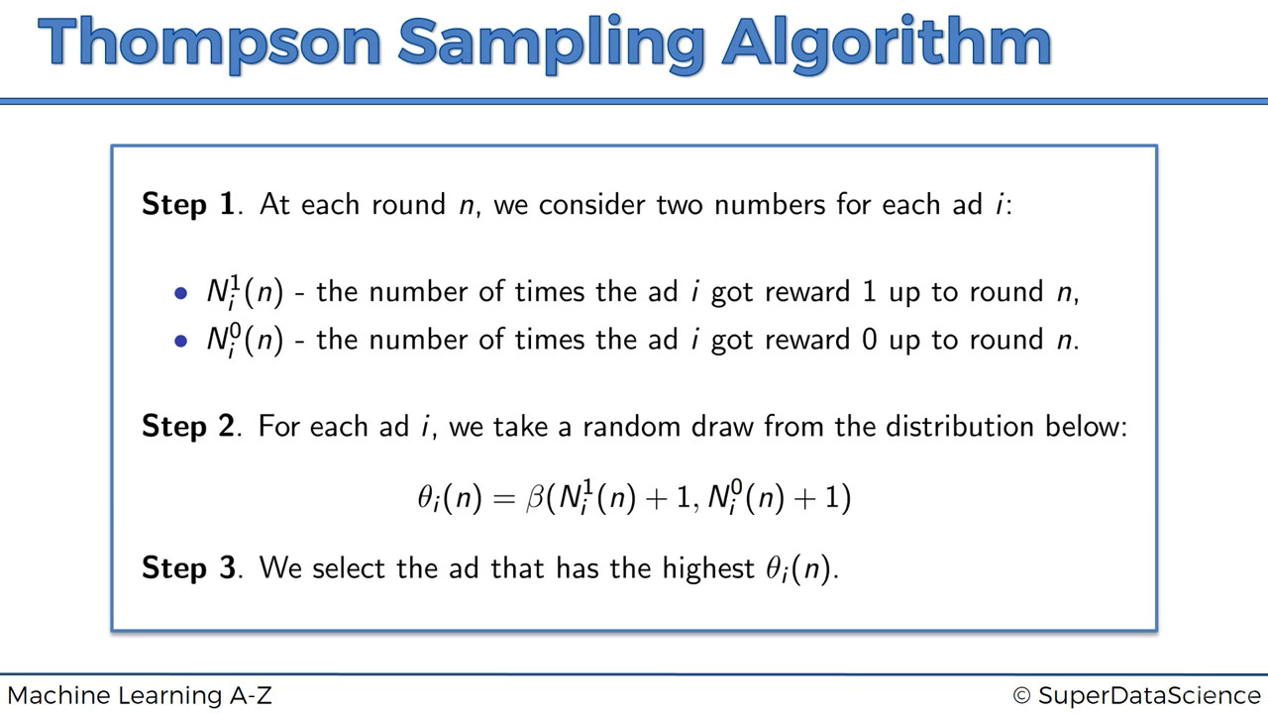

Slide 16
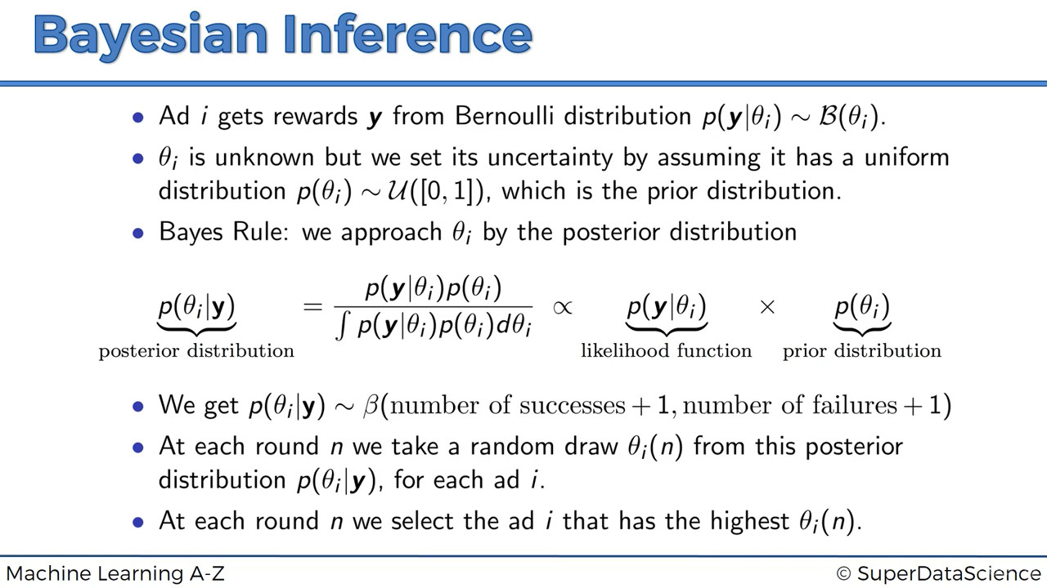

Slide 17
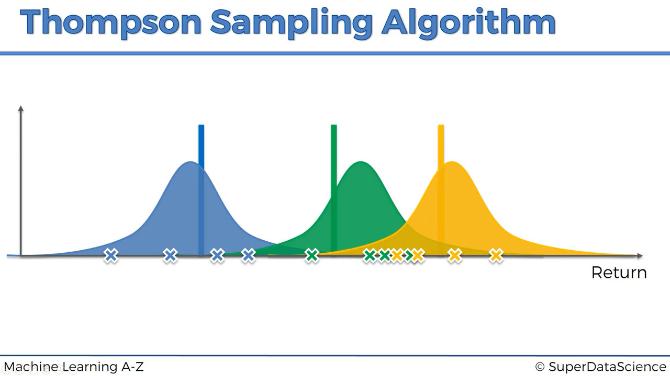
Expected Returns for each bandits
(Not known to user)
Initial Distribution based on some trial runs

Slide 18
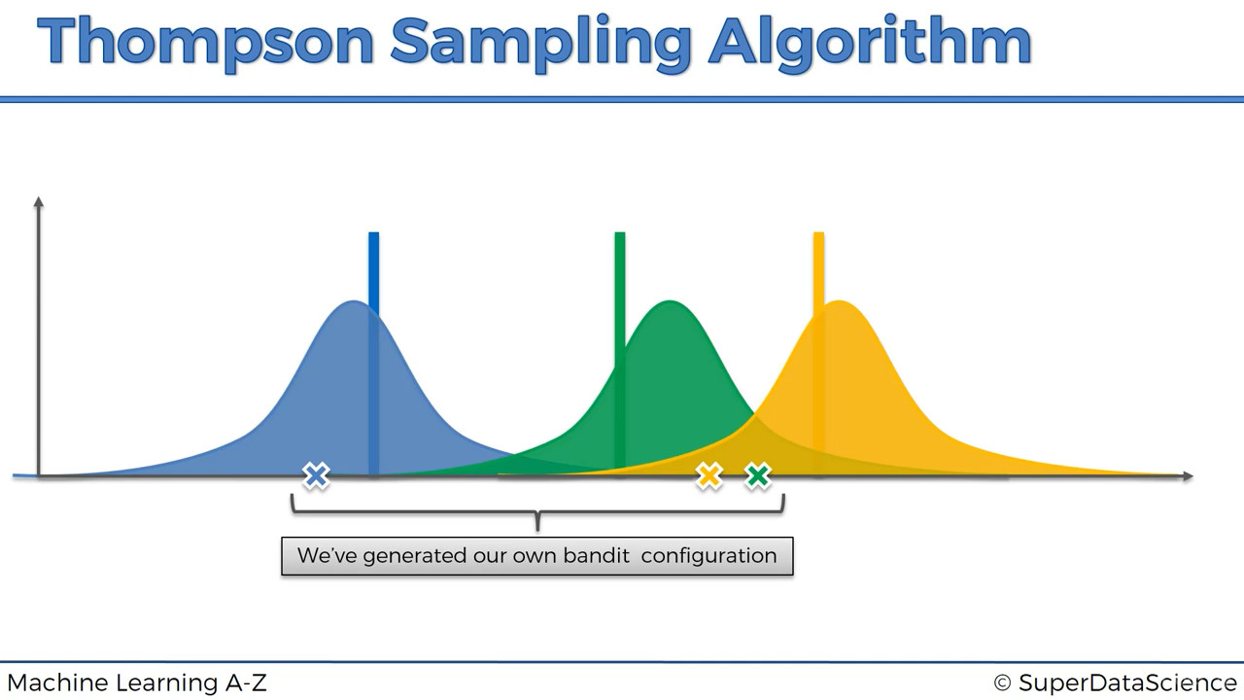

Slide 19
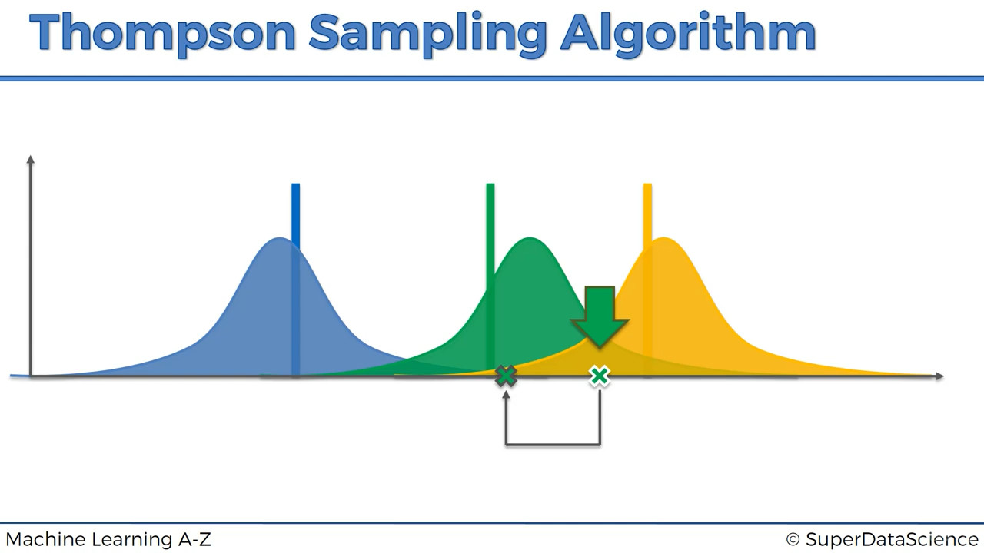
Pick the one having highest return
Actual Return
in real world

Slide 20
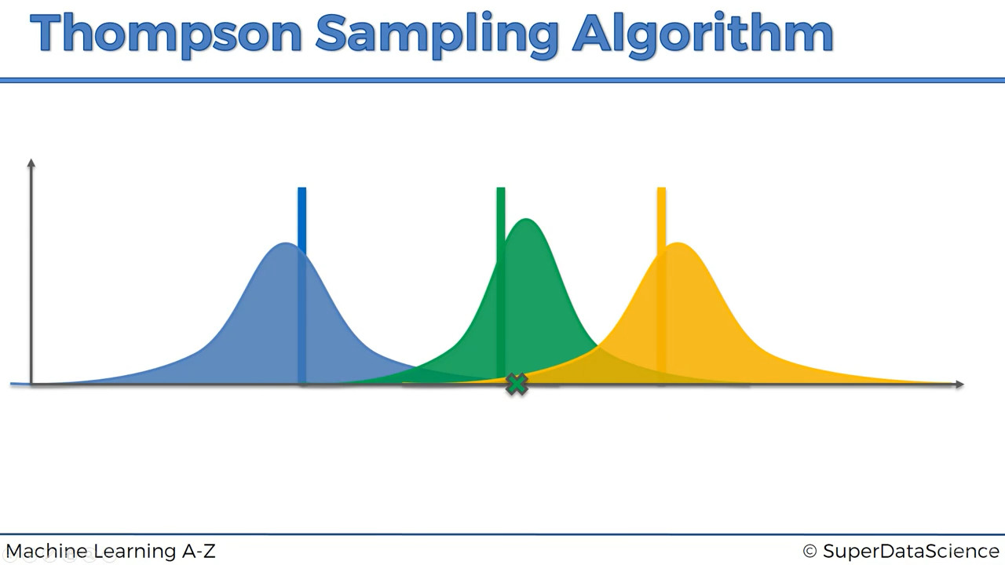
Adjust the prior distribution
by adding new information
Actual Return
in real world

Slide 21
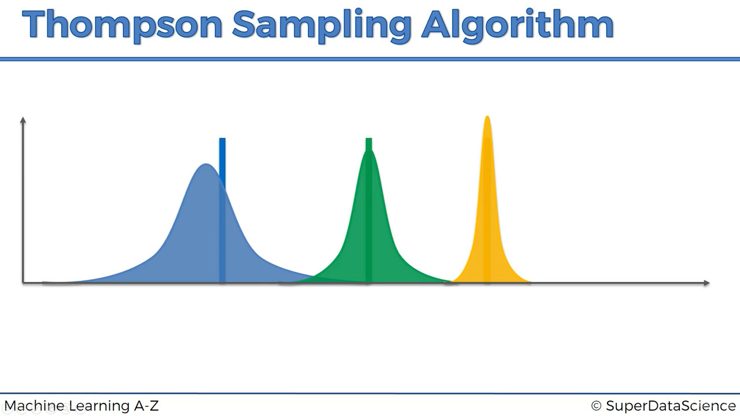
After many rounds...
Select this bandit
due to higher returns

Slide 22
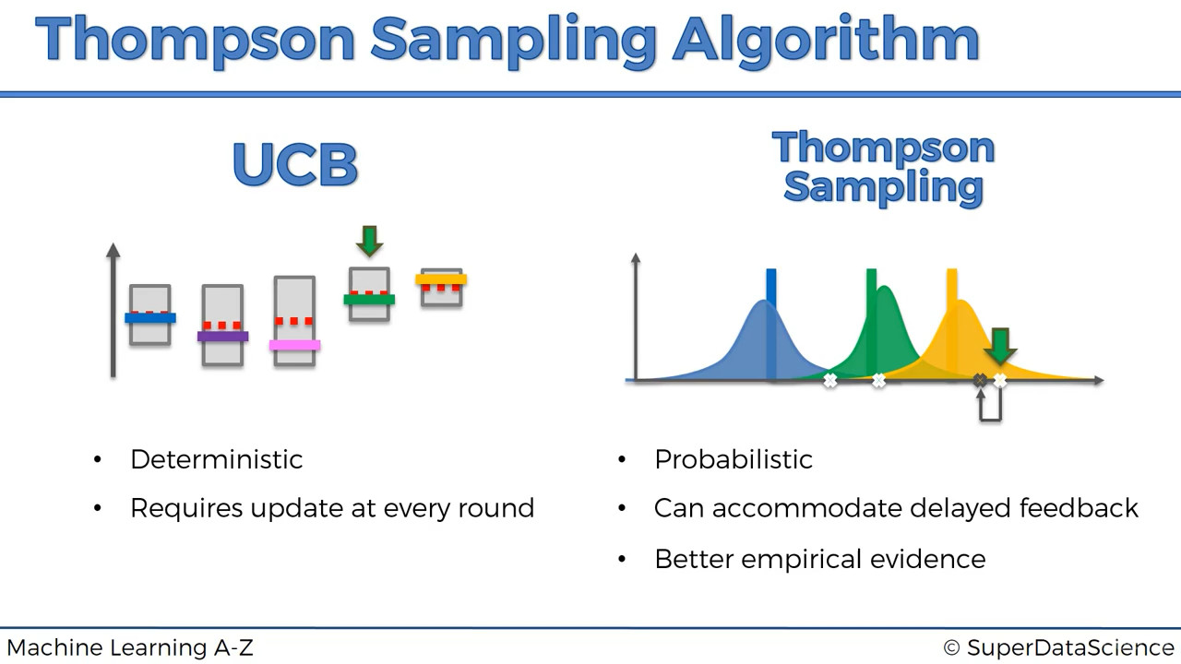
Conclusion

